Slide 1
The Eternal State
Revelation Chapters 21 and 22

Slide 2
Review from last time…
Rev 20:11-15, Then I saw a great white throne and Him who sat upon it, from whose presence earth and heaven fled away, and no place was found for them. 12 And I saw the dead, the great and the small, standing before the throne, and books were opened; and another book was opened, which is the book of life; and the dead were judged from the things which were written in the books, according to their deeds. 13 And the sea gave up the dead which were in it, and death and Hades gave up the dead which were in them; and they were judged, every one of them according to their deeds. 14 Then death and Hades were thrown into the lake of fire. This is the second death, the lake of fire. 15 And if anyone’s name was not found written in the book of life, he was thrown into the lake of fire.

Slide 3
QUESTION: Do both believers and unbelievers have bodies?
QUESTION: Where do believers go and how long will they be there?
QUESTION: Where do unbelievers go, and how long will they be there?
  Lake of Fire, Rev 20:10, And the devil who deceived them was thrown into the lake of fire and brimstone, where the beast and the false prophet are also; and they will be tormented day and night forever and ever.
  2 Thes 1:6-9, For after all it is only just for God to repay with affliction those who afflict you, 7 and to give relief to you who are afflicted and to us as well when the Lord Jesus will be revealed from heaven with His mighty angels in flaming fire, 8 dealing out retribution to those who do not know God and to those who do not obey the gospel of our Lord Jesus. 9 These will pay the penalty of eternal destruction, away from the presence of the Lord and from the glory of His power,

Slide 4
STATEMENT: However, there are many Christians who adhere to an annihilationist view
  This view relies on verses that talk about “destruction”, but they reject eternal torment.
  One of the major annihilationism proponents, Clark Pinnock, says this:
    “The doctrine of eternal torture makes God out to be morally worse than Hitler, who maintains an everlasting Auschwitz for his enemies whom he does not even allow to die. How can one love a God like that?”
    So, is this Clark Pinnock morally superior to God? He should reconsider his words!
ANSWER: “Punishment in hell is defined by the word aionios, which is the word eternal or everlasting. There are people who would like to redefine that word aionios and say, "Well, it doesn't really mean forever." But if you do that with hell, you've just done it with heaven, because the same word is used to describe both. If there is not an everlasting hell, then there is not an everlasting heaven. And I'll go one beyond that. The same word is used to describe God. And so if there is not an everlasting hell, then there is not an everlasting heaven, nor is there an everlasting God. It is clear that God is eternal; and, therefore, that heaven is eternal, and so is hell.” – John MacArthur

Slide 5
QUESTION: What do we know about heaven? How many heavens are there?
The Earth’s atmosphere (Heb: shamayim)
  Gen 1:20, “let birds fly above the earth in the open expanse of the heavens.”
  Job 12:7, ““But now ask the beasts, and let them teach you; and the birds of the heavens, and let them tell you.”
  Eze 38:20, The fish of the sea, the birds of the heavens, the beasts of the field, all the creeping things that creep on the earth.

Slide 6
Interstellar space (Heb: shamayim)
  Gen 15:5, And He took [Abraham] outside and said, “Now look toward the heavens, and count the stars, if you are able to count them.” And He said to him, “So shall your descendants be.”
  Deu 4:19, beware not to lift up your eyes to heaven and see the sun and the moon and the stars, all the host of heaven, and be drawn away and worship them and serve them
  Psa 8:3-4, When I consider Your heavens, the work of Your fingers, the moon and the stars, which You have ordained; 4 What is man that You take thought of him, and the son of man that You care for him?

Slide 7
The dwelling place of God (Heb: shamayim, Gr: Ouranos – The Planet Uranus, and Uranium)
Deu 4:39, Know therefore today, and take it to your heart, that the Lord, He is God in heaven above and on the earth below; there is no other.
Job 22:12, 14, “Is not God in the height of heaven? Look also at the distant stars, how high they are! … And he walks on the vault of heaven.” Vault - circle or circuit
  The sense is there is a limit to the circle of the universe, and God is outside of that.
2 Cor 12:2, 4, I know a man in Christ who fourteen years ago—whether in the body I do not know, or out of the body I do not know, God knows—such a man was caught up to the third heaven” … “was caught up into Paradise and heard inexpressible words, which a man is not permitted to speak.”
This is Paul’s experience of seeing the dwelling place of God

Slide 8
Rev 21:1, Then I saw a new heaven and a new earth; for the first heaven and the first earth passed away, and there is no longer any sea.
This is the recreation!
  Everything was uncreated (melted away) in chapter 20, now it is all brand new.
  Isa 65:17, “For behold, I create new heavens and a new earth; and the former things will not be remembered or come to mind.”
  Isa 66:22, “For just as the new heavens and the new earth which I make will endure before Me,” declares the Lord, “So your offspring and your name will endure.”
  We know this is very different from the current heaven and earth, “there is no sea.”
    The current earth is 75% oceans.
    Our earthly bodies are 90% water.
    We will be very different and so will the new planet!

Slide 9
Rev 21:2, And I saw the holy city, new Jerusalem, coming down out of heaven from God, made ready as a bride adorned for her husband.
We need to read this verse literally, this is an actual city. Prepared by God.
Then we have a simile, that the city is adorned “as” a bride (made beautiful in every way)
QUESTION: What’s another reason the Holy City can be considered a bride?
  God’s holy people dwell there!
  The bride is now not just the New Testament Church, but all redeemed believers!
QUESTION: How many Jerusalems will there have been by this time?
  Pre-Mil Jerusalem, which has already been ransacked and rebuilt several times.
  Millennium Jerusalem, which will stand at the highest point of the planet (Isa 2:2)
This is the third Jerusalem that comes down from heaven to the new earth.

Slide 10
This is a holy, eternal city.
QUESTION: What is a city?
  “The concept of a city includes relationships, activity, responsibility, unity, socialization, and cooperation. Unlike the evil cities of the present earth, the people in the New Jerusalem will live together in perfect harmony.” – John MacArthur
QUESTION: Does the New Jerusalem already exist, and where is it now?
  What does the verse (Rev 21:2) say about where it comes from?
  Heb 12:22-24, But you have come to Mount Zion and to the city of the living God, the heavenly Jerusalem, and to myriads of angels, 23 to the general assembly and church of the firstborn who are enrolled in heaven, and to God, the Judge of all, and to the spirits of the righteous made perfect, 24 and to Jesus, the mediator of a new covenant, and to the sprinkled blood, which speaks better than the blood of Abel.
The sense is that the New Jerusalem is the Father’s house. Perhaps the capital city of heaven.

Slide 11
Rev 21:3, And I heard a loud voice from the throne, saying, “Behold, the tabernacle of God is among men, and He will dwell among them, and they shall be His people, and God Himself will be among them;”
QUESTION: What’s a tabernacle?
  Oxford, (in biblical use) a fixed or movable habitation
  John 14:1-3, “Do not let your heart be troubled; believe in God, believe also in Me. 2 In My Father’s house are many dwelling places; if it were not so, I would have told you; for I go to prepare a place for you. 3 If I go and prepare a place for you, I will come again and receive you to Myself, that where I am, there you may be also.
  No longer will God’s glory and presence be veiled
  Our fellowship with Jesus will be full and complete
    1 John 3:2, Beloved, now we are children of God, and it has not appeared as yet what we will be. We know that when He appears, we will be like Him, because we will see Him just as He is. QUESTION: Who wrote 1 John?

Slide 12
Rev 21:4-5, and He will wipe away every tear from their eyes; and there will no longer be any death; there will no longer be any mourning, or crying, or pain; the first things have passed away. 5 And He who sits on the throne said, “Behold, I am making all things new.” And He said, “Write, for these words are faithful and true.”
QUESTION: Was there death during the Millennium?
  Isa 65:20 implies that yes, so would there still have been crying? Yes.
  Others believe that death in the Millennium is eliminated, but this verse implies otherwise.
    there will no longer be any death
  MacArthur believes there will be death, but saints are immediately translated and glorified.

Slide 13
QUESTION: Why will there be no more crying now?
  Nothing to be sorrowful about. No regrets, no pain.
  Because?
    The first things have passed away!
    God is making all things new.
QUESTION: Why do you suppose Jesus has to remind John to “write” what he is seeing?
  Maybe John is overwhelmed with what he sees and has lost his concentration?

Slide 14
Rev 21:6-8, It is done. I am the Alpha and the Omega, the beginning and the end. I will give to the one who thirsts from the spring of the water of life without cost. 7 He who overcomes will inherit these things, and I will be his God and he will be My son. 8 But for the cowardly and unbelieving and abominable and murderers and immoral persons and sorcerers and idolaters and all liars, their part will be in the lake that burns with fire and brimstone, which is the second death.”
Once again we see the stark contrast in destination between believers and unbelievers

Slide 15
Characteristics of unbelievers
  Cowardly – Where was King Saul when he was being selected as King (1 Sam 10:22)?
  Unbelieving – those who refuse to believe God
  Abominable – disgusting, detestable
  Murderers
  Immoral - pornos
  Sorcerers - pharmakos
  Idolaters – a worshipper of images
  All liars – pseudes (pseudos, fakes, deceivers, hypocrites)

Slide 16
Rev 21:9-11, Then one of the seven angels who had the seven bowls full of the seven last plagues came and spoke with me, saying, “Come here, I will show you the bride, the wife of the Lamb.” 10 And he carried me away in the Spirit to a great and high mountain, and showed me the holy city, Jerusalem, coming down out of heaven from God, 11 having the glory of God. Her brilliance was like a very costly stone, as a stone of crystal-clear jasper.
QUESTION: Which angel shows John the Bride?
QUESTION: Where does the angel take John to see the Bride?
QUESTION: And what does the angel show John as the Bride?
  No more simile here. The holy city IS the Bride because it is comprised of all the faithful.
  The city draws its character from its occupants.
The city is brilliant (to shine or to glow) like Jasper.
QUESTION: Why is the city shining?

Slide 17
Rev 21:12-14, It had a great and high wall, with twelve gates, and at the gates twelve angels; and names were written on them, which are the names of the twelve tribes of the sons of Israel. 13 There were three gates on the east and three gates on the north and three gates on the south and three gates on the west. 14 And the wall of the city had twelve foundation stones, and on them were the twelve names of the twelve apostles of the Lamb.
QUESTION: Is this passage describing a physical city or a spiritual city?
  Hint: High wall, East, North, South, West, gates with names, foundation stones
The twelve gates have the names of the twelve tribes of Israel
The twelve foundation stones of the wall have the names of the twelve apostles
  This is further support for God’s covenant with Israel, as well as with the church

Slide 18
Rev 21:15-17, The one who spoke with me had a gold measuring rod to measure the city, and its gates and its wall. 16 The city is laid out as a square, and its length is as great as the width; and he measured the city with the rod, fifteen hundred miles; its length and width and height are equal. 17 And he measured its wall, seventy-two yards, according to human measurements, which are also angelic measurements.
Further proof this is a physical city:
The city is laid out as a cube, 1500 miles on each side (12,000 stadia, a stadia = about 600 ft)
  Some try to make it a pyramid, but the language doesn’t allow for that interpretation.
    Plus, pyramids are also often associated with the occult.
    Henry Morris says this, “The language of the passage [is] much more naturally understood to mean a cube, with the length and breadth and height all same.”
    He also argues against a pyramid shape because of, “the pyramid’s apex being dedicated to the worship of the sun, or of the host of heaven” – The Revelation Record, page 450.

Slide 19
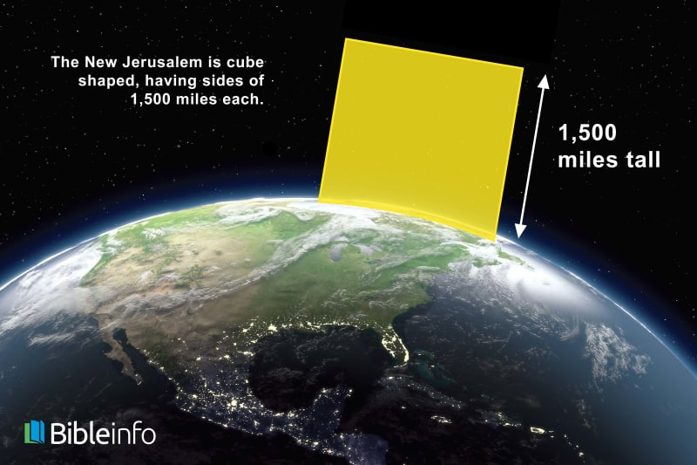

Slide 20
John 14:2, In My Father’s house are many dwelling places; if it were not so, I would have told you; for I go to prepare a place for you.
A quick calculation reveals that the city would be able to contain about 1,500,000,000,000,000 ( 1.5 quadrillion) apartments if each apartment was 12 feet high (3.66 m) and contained 2800 sq. ft (260.1 sq. m). – neverthirsty.org
But a city is not made up of just apartments! It has parks, rivers, concert halls, etc.
QUESTION: So how many people have ever been born on the planet?
A better question is: How many people have ever been conceived on earth since Adam and Eve?
  Christians believe life begins at conception, not at birth!

Slide 21
Current situation (these are all estimated numbers):
250,000,000 pregnancies each year around the world
120,000,000 are “unintended” pregnancies according to the UN
50,000,000 fetuses are aborted every year
World population in 2022, 8 billion, so that’s about 4 billion women in total
So, about 6% of women are pregnant every year. (lower in the west, higher in undeveloped countries)

Slide 22
The world has two distinct geometric population growth epochs; Pre-flood, post-flood
AND, Jesus may be hinting at something when he says this:
  Mat 24:36-39, “But of that day and hour no one knows, not even the angels of heaven, nor the Son, but the Father alone. 37 For the coming of the Son of Man will be just like the days of Noah. 38 For as in those days before the flood they were eating and drinking, marrying and giving in marriage, until the day that Noah entered the ark, 39 and they did not understand until the flood came and took them all away; so will the coming of the Son of Man be.

Slide 23
Let’s say he was also talking not just about the surprise nature of the event, but also the population, because he says, “marrying and giving in marriage” (this is a reasonable assumption)
  Today the population is about 8 billion. We could view the pre-flood population as the same 8 billion, and this is not even a stretch numerically!
  Last year the global growth rate was 0.91%, but since the flood it has been much lower.
    This due to wars, famines, pestilence, genocide
  The flood occurred 1,656 years after creation.
  Then about 4344 years have occurred since the flood (Total 6,000 years).
  When we extrapolate pre-flood and post flood population growth rates we find:
  https://www.omnicalculator.com/math/exponential-growth

Slide 24
 | Initial Pop | Rate of Chg | Years | Final Pop
Pre-Flood | 2 | 1.35% | 1656 | 8,813,836,943
Post-Flood | 8 | 0.48% | 4344 | 8,649,421,046
Now add 3% (6%/2, since half are men)
Pre-flood | 2 | 1.38% | 1656 | 14,388,551,685
Post-flood | 8 | 0.51% | 4344 | 31,635,291,963
 |  |  | Total Conceptions | 46,023,843,648

Slide 25
    These numbers are estimates, based on assumptions, but are very conservative!
      During the “Baby Boom” the annual population growth rate was 2.2%
      People alive before the flood represented 61% of pre-flood conceptions.
      People alive today represent 27% of conceptions since the flood.
  A BIG PROBLEM for old earth advocates is why there aren’t hundreds of trillions of people!
    They use 200,000 years as their time frame. Even with only 0.016% population growth (ONLY 1.7% of today’s 0.91% number) we get:
 | Initial Pop | Rate of Chg | Years | Final Pop
Old Earth | 2 | 0.016% | 200000 | 157 trillion

Slide 26
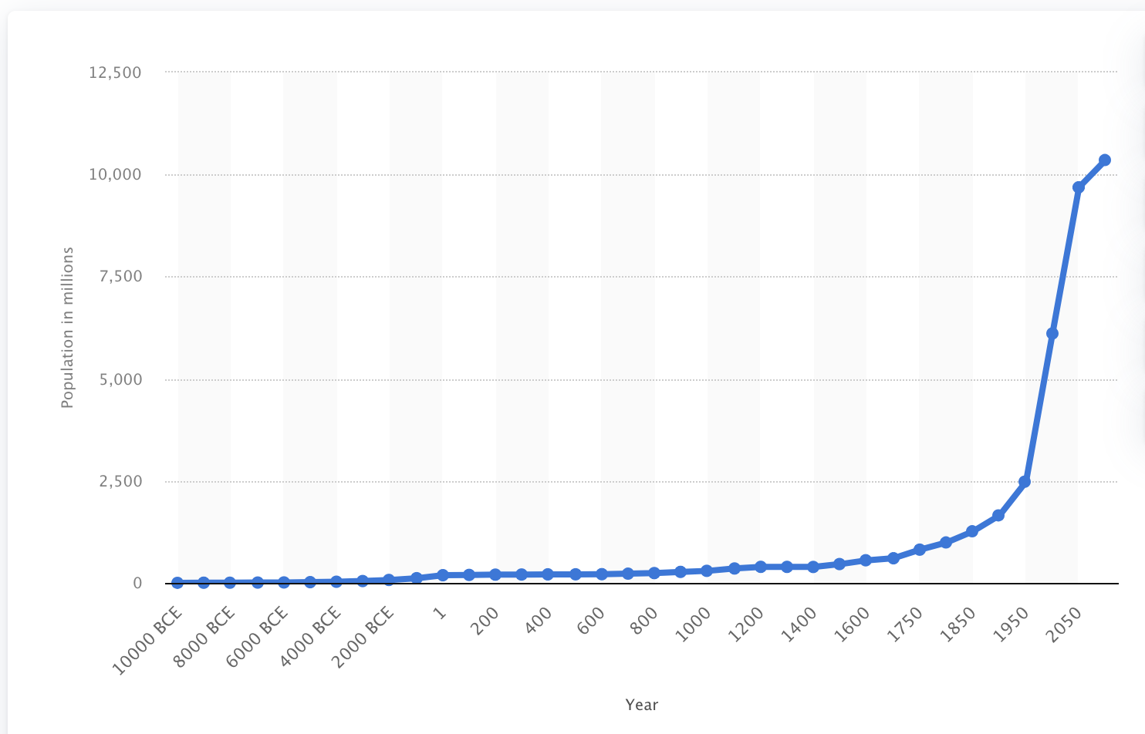
    Google “how many people have ever lived on earth?”
    So, their charts have to look like this (and this one only goes back 10,000 years):

Slide 27
  Jesus also said:
    Mat 7:13-14, “Enter through the narrow gate; for the gate is wide and the way is broad that leads to destruction, and there are many who enter through it. 14 For the gate is small and the way is narrow that leads to life, and there are few who find it.”
  So, bottom line, the New Jerusalem has plenty of room for the saints!

Slide 28
Rev 21:18-21, The material of the wall was jasper; and the city was pure gold, like clear glass. 19 The foundation stones of the city wall were adorned with every kind of precious stone. The first foundation stone was jasper; the second, sapphire; the third, chalcedony; the fourth, emerald; 20 the fifth, sardonyx; the sixth, sardius; the seventh, chrysolite; the eighth, beryl; the ninth, topaz; the tenth, chrysoprase; the eleventh, jacinth; the twelfth, amethyst. 21 And the twelve gates were twelve pearls; each one of the gates was a single pearl. And the street of the city was pure gold, like transparent glass.
The gold of the city is transparent.
Gems are everywhere, even each of the twelve gates are made of a single pearl

Slide 29
Rev 21, 22-27, I saw no temple in it, for the Lord God the Almighty and the Lamb are its temple. 23 And the city has no need of the sun or of the moon to shine on it, for the glory of God has illumined it, and its lamp is the Lamb. 24 The nations will walk by its light, and the kings of the earth will bring their glory into it. 25 In the daytime (for there will be no night there) its gates will never be closed; 26 and they will bring the glory and the honor of the nations into it; 27 and nothing unclean, and no one who practices abomination and lying, shall ever come into it, but only those whose names are written in the Lamb’s book of life.
God is the temple.
His glory illuminates everything
There will be nations
The earth will have kings that come and go from the earth to the city. The gates are never closed.

Slide 30
Rev 22:1-5, Then he showed me a river of the water of life, clear as crystal, coming from the throne of God and of the Lamb, 2 in the middle of its street. On either side of the river was the tree of life, bearing twelve kinds of fruit, yielding its fruit every month; and the leaves of the tree were for the healing of the nations. 3 There will no longer be any curse; and the throne of God and of the Lamb will be in it, and His bond-servants will serve Him; 4 they will see His face, and His name will be on their foreheads. 5 And there will no longer be any night; and they will not have need of the light of a lamp nor the light of the sun, because the Lord God will illumine them; and they will reign forever and ever.
There is a river of the water of life flowing from the throne.
The trees of life are there, bearing fruit every month.
  This is a return to the garden before the fall, when the tree of life was available
The curse is gone.
We will see his face.
  1 Cor 13:12, For now we see in a mirror dimly, but then face to face; now I know in part, but then I will know fully just as I also have been fully known.

Slide 31
The rest of chapter 22 are admonishments are warnings. But I’d like to highlight a couple of passages:
Rev 22:12, “Behold, I am coming quickly, and My reward is with Me, to render to every man according to what he has done. 13 I am the Alpha and the Omega, the first and the last, the beginning and the end.”
A reminder that he is coming quickly! And his reward is with Him!
He is the first, and the last, meaning he created, uncreated, recreated, and holds all things

Slide 32
Rev 22:18-21, I testify to everyone who hears the words of the prophecy of this book: if anyone adds to them, God will add to him the plagues which are written in this book; 19 and if anyone takes away from the words of the book of this prophecy, God will take away his part from the tree of life and from the holy city, which are written in this book. 20 He who testifies to these things says, “Yes, I am coming quickly.” Amen. Come, Lord Jesus. 21 The grace of the Lord Jesus be with all. Amen.
A warning not to add to the prophecy of this book nor take away from it
  The warning has consequences!
    He will experience the plagues described in the book
    He will not have access to the tree of life
  Many who take the entire bible seriously extend this warning to all of scripture
He is coming quickly!

Slide 33
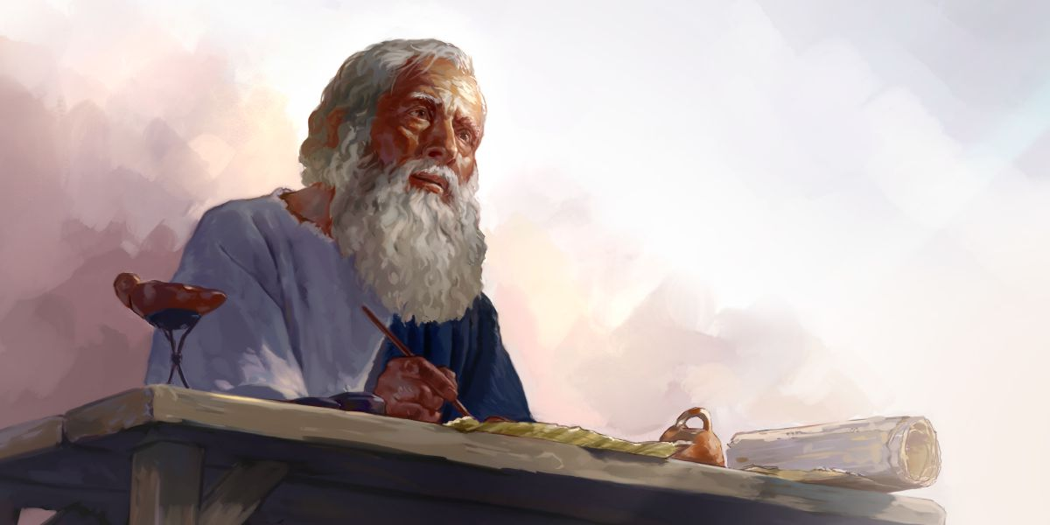

QUESTION: Any final thoughts or questions?

